Slide 1


Customer Shopping Behaviour Analysis
Uncovering insights from 3,900 purchases to guide strategic business decisions
Notes:
1

Slide 2

Dataset Overview
3,900
18
37
Total Purchases
Data Columns
Missing Values
Comprehensive transaction data
Customer demographics & behavior
Only in Review Rating column
Notes:
2

Slide 3
Data Preparation Process
1
2
3
Data Loading
Initial Exploration
Missing Data Handling
Imported dataset using pandas
Structure check and summary statistics
Imputed Review Rating with median values
5
Database Integration
Connected to SQL for analysis
Notes:
3

Slide 4
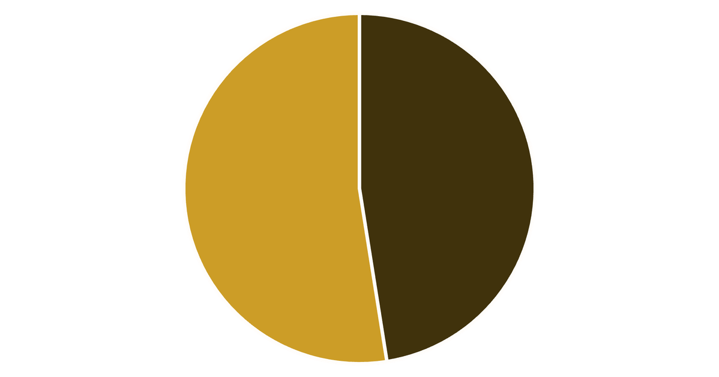
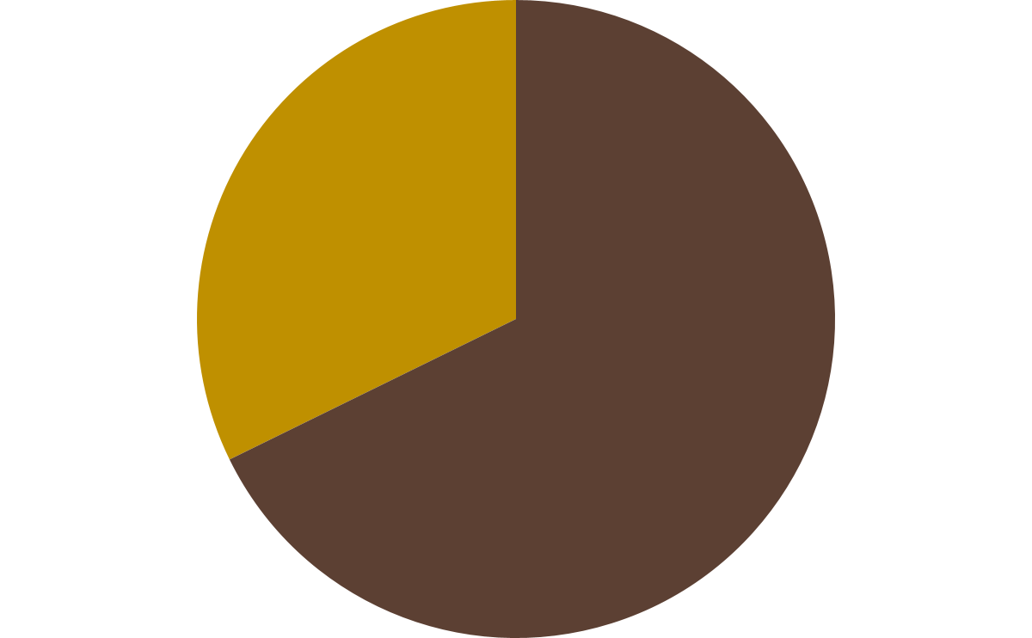

Revenue by Gender Analysis
Key Insight
Male customers generate more than double the revenue of female customers (68% vs 32%)
Gender-based marketing strategies could optimize revenue streams
Male
Female
Notes:
4

Slide 5

High-Value Discount Users
Customers using discounts while spending above average
Smart Shoppers
High spenders who maximize value with discounts
Strategic Opportunity
Target premium customers with exclusive offers
Notes:
5

Slide 6

Top-Rated Products
Gloves : 3.86
Sandals : 3.84
Boots : 3.82
Highest customer satisfaction
Consistently excellent reviews
Strong customer approval
Notes:
6

Slide 7


Shipping Preferences Impact
Express Shipping
Standard Shipping
$60
$58
Average purchase amount
Average purchase amount
Express shipping customers spend 3.45% more per transaction
Notes:
7

Slide 8
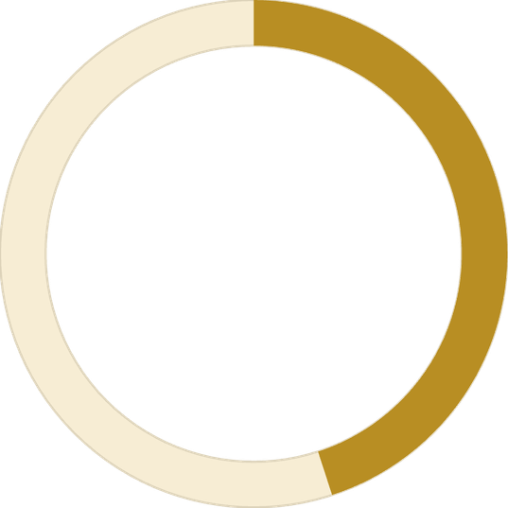

Loyal Customers
27%
91%
Revenue Share
Loyalty Rate
From subscription customers
Repeat purchase frequency
Notes:
8

Slide 9



Customer Segmentation
New
1
2% - First Time Buyers
2
Returning
16% - Regular Shoppers
3
Loyal
82% - High Value Customers
Maintaining our massive 82% Loyal customer base while finding new ways to acquire first time-buyers.
Notes:
9

Slide 10





Strategic Recommendations
Boost Subscriptions
Promote exclusive benefits for subscribers
Loyalty Programs
Reward repeat buyers to increase retention
Targeted Marketing
Focus on high-revenue segments and express users
Product Positioning
Highlight top-rated products in campaigns
Notes:
10

